Slide 1
Agenda
Main Contributions
System Model
Preliminary Results

Slide 2
Main Contributions

Slide 3
We want to show that:
Model-based Bayesian detection can improve decoding performance. We showed in the previous paper that this approach improves SER + more calibrated probabilities, so it can translate into improved decoding.
Model-based Bayesian decoding improves decoding performance directly.

Slide 4
System Model

Slide 5
Implemented encoding and decoding blocks:
Encoding is BCH(63,36) / BCH(63,45) / BCH(127,64)
Decoding is regular Belief Propagation (BP) (later- weighted BP (WBP))
SER
BER
pilots
info
Noisy Channel
Message generator
Encoding
QPSK Modulation
Train + Detect
BP Decoding
pilots
info
Message generator
Encoding
QPSK Modulation
Train + Detect
BP Decoding
pilots
info
Message generator
Encoding
QPSK Modulation
Train + Detect
BP Decoding
pilots
info
Message generator
Encoding
QPSK Modulation
Train + Detect
BP Decoding

Slide 6
Results – Point 1

Slide 7
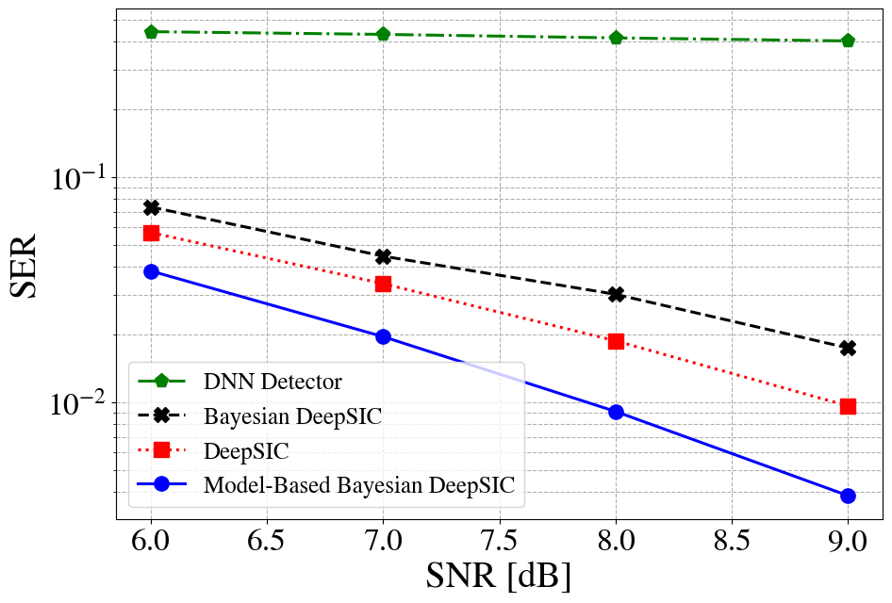
SER

Slide 8
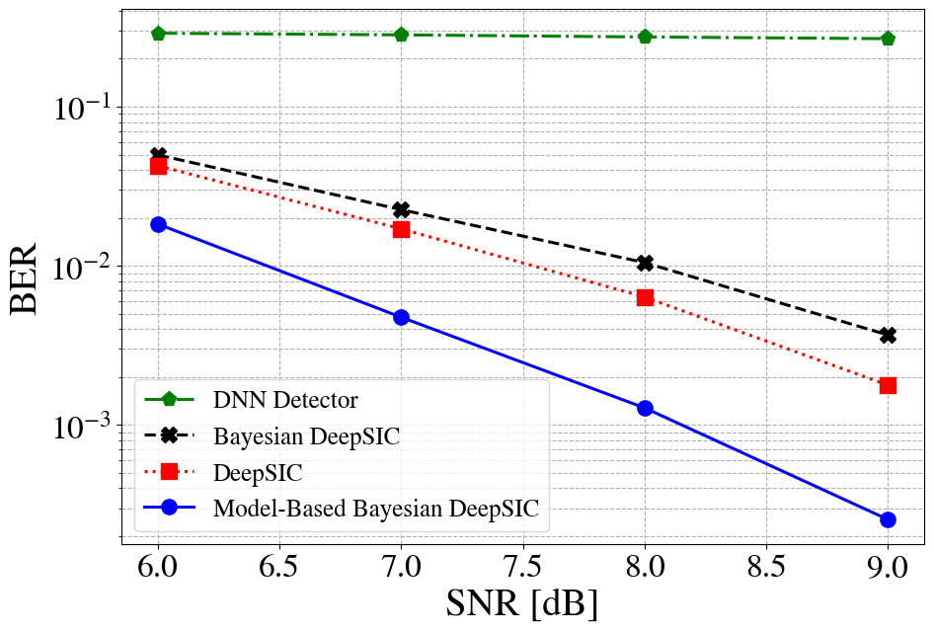
BER

Slide 9
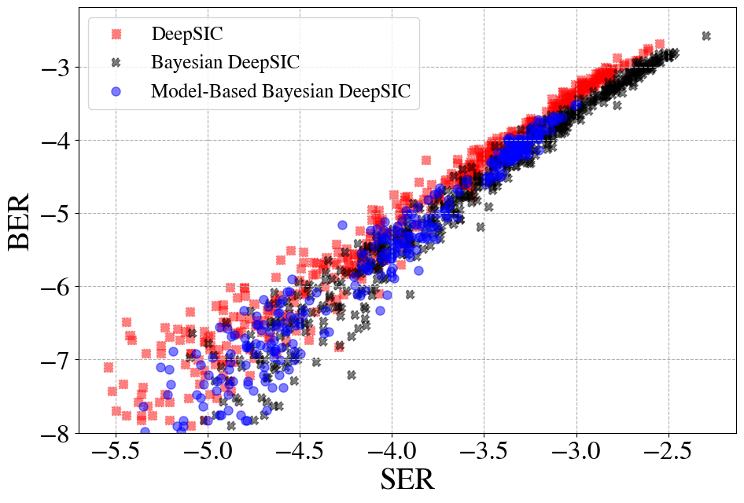
BER vs SER

Slide 10
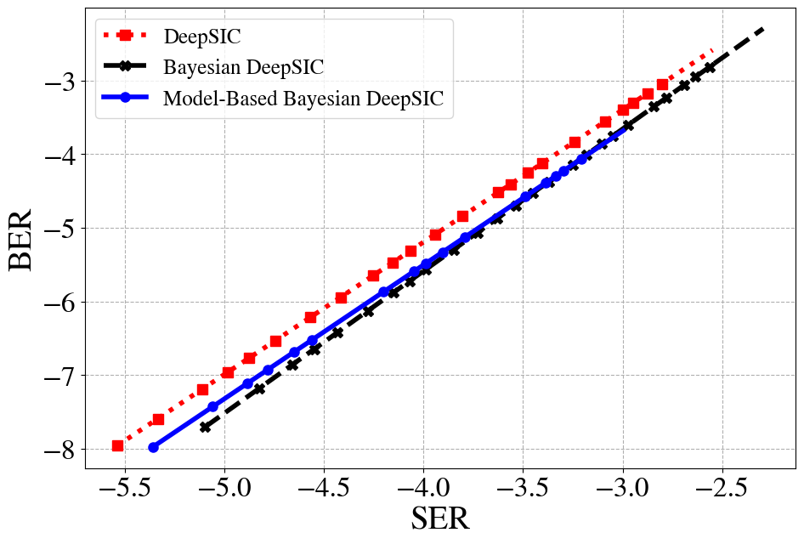
BER vs SER

Slide 11
Results – Point 2

Slide 12
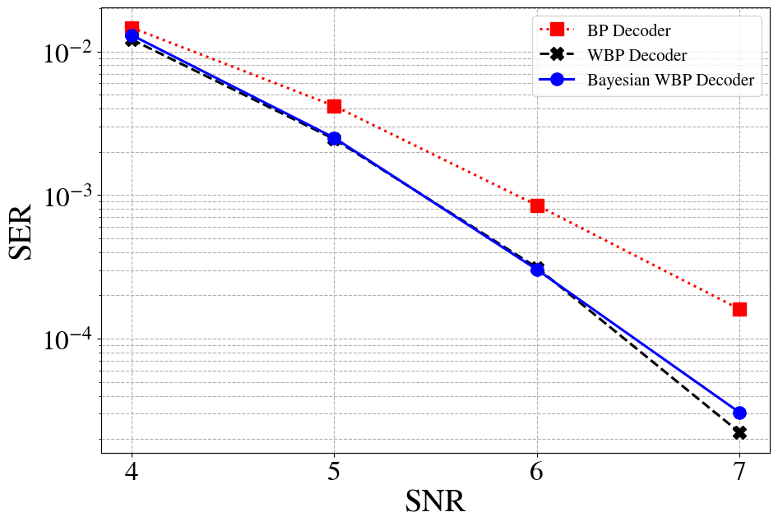
BCH (63,36) –5 iterations

Slide 13
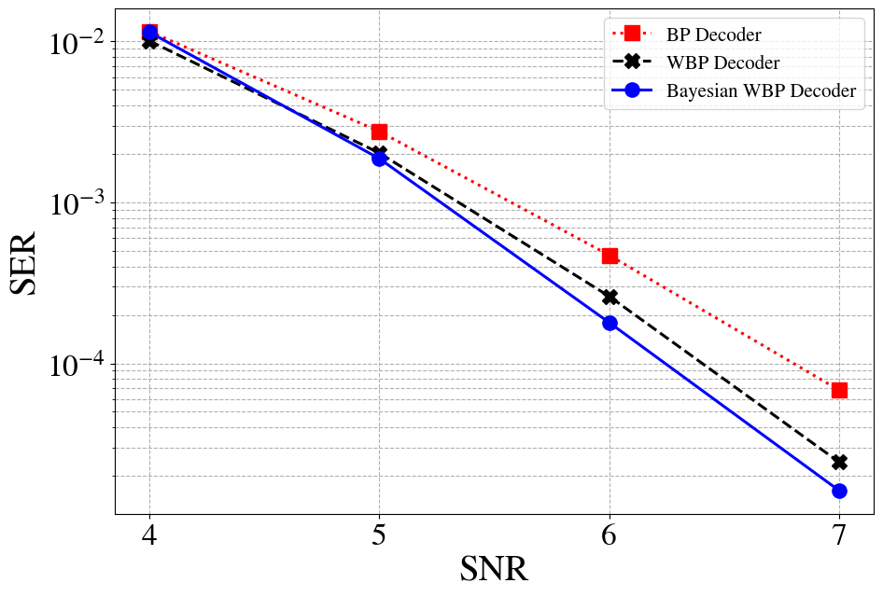
BCH (63,36) – 10 iterations

Slide 14
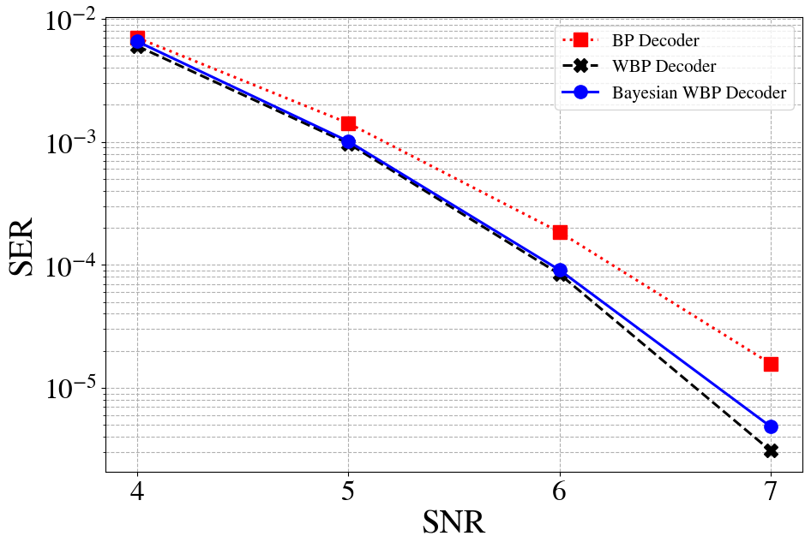
BCH (63,45) –5 iterations

Slide 15
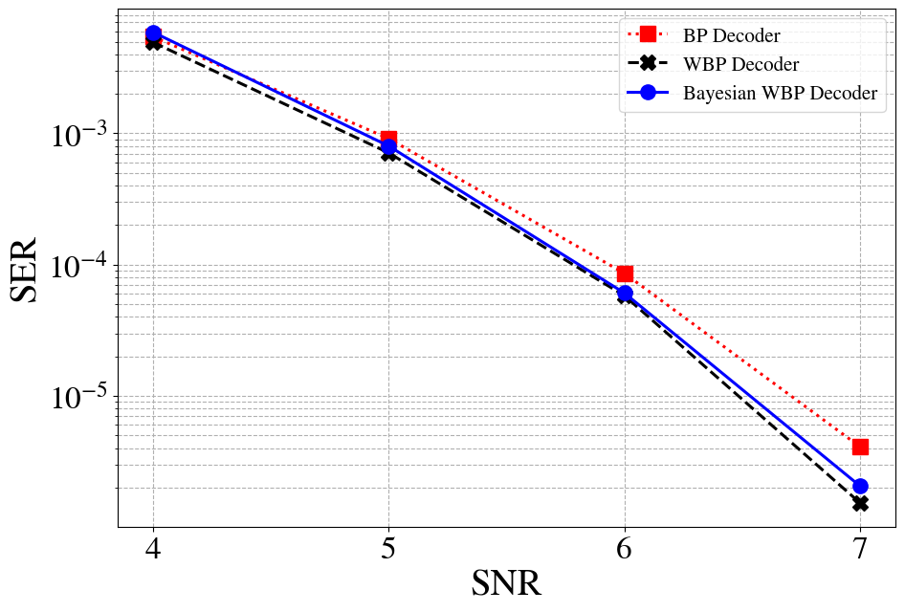
BCH (63,45) – 10 iterations

Slide 16
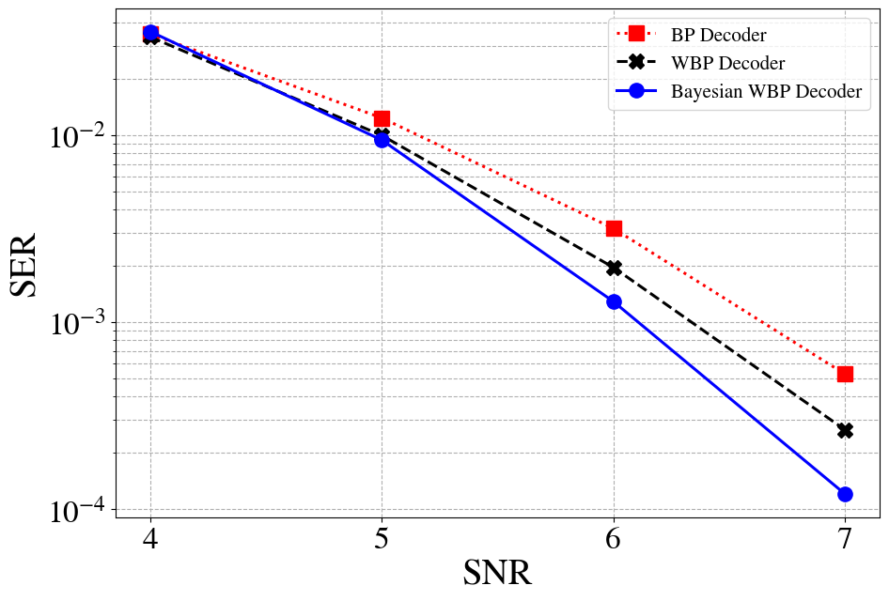
BCH (127,64) – 5 iterations

Slide 17
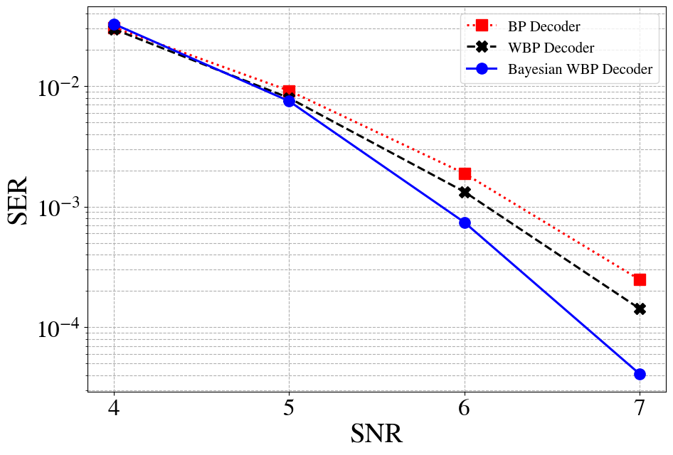
BCH (127,64) – 10 iterations

Slide 18
Next Results – Combine the Two Points

